Slide 1
Lecture 7B: Networking

Slide 2
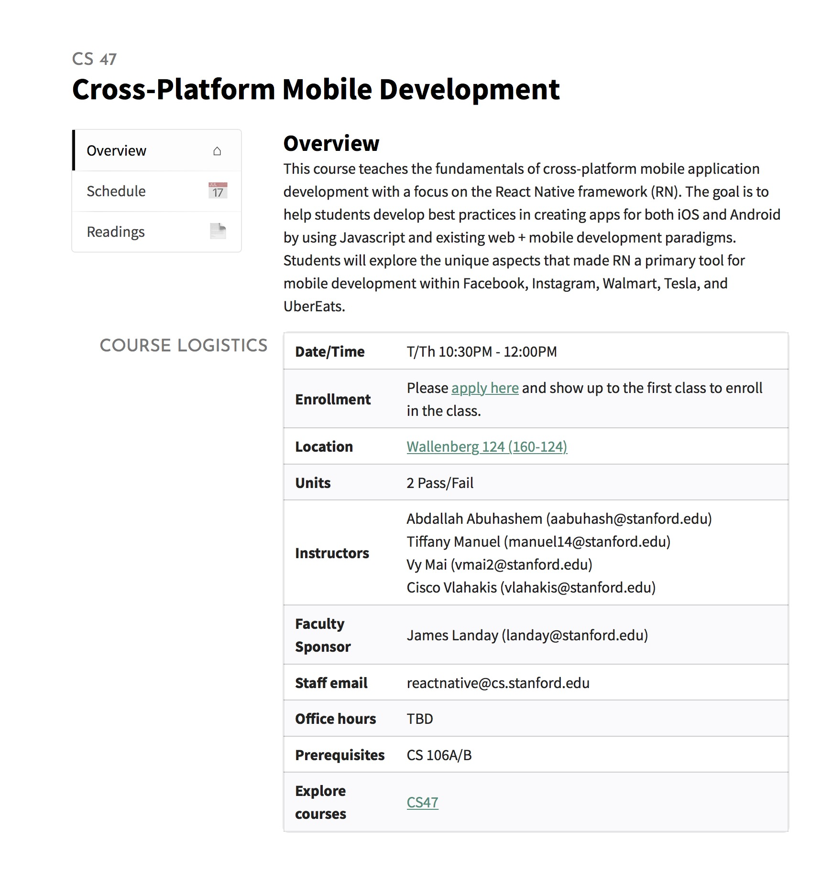
https://cs47.stanford.edu
To access lectures use Stanford email

Slide 3
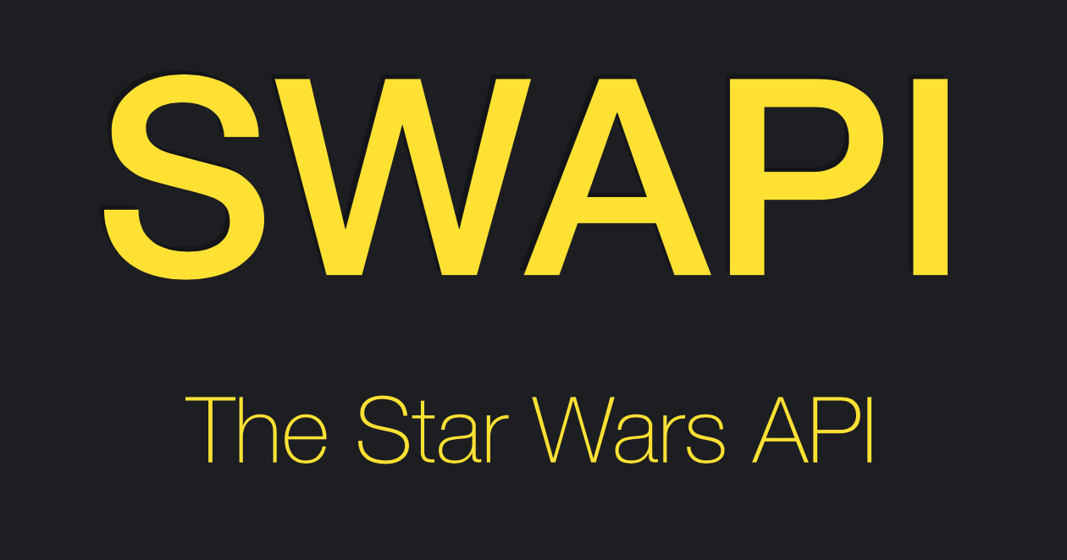
Live Exercise
Spaceship Store
Download
https://swapi.co
STARTER CODE

Slide 4
Promises
Not the ones people make
A Promise is a proxy for a value not necessarily known when the promise is created.
USAGE
Running asynchronous functions:
Networking calls
Accessing storage
const promise = new Promise((resolve, reject) => {
setTimeout(() => {
resolve('foo');
}, 1000);
});
promise.then(value => {
console.log(value);
// Expected Output: 'foo'
});
USEFUL LINKS / JavaScript Demo / Chaining Promises

Slide 5
Promises
Not the ones people make
THE SIMPLE VERSION
Returns a value
PROMISE
Resolved
Pending
Something went wrong,
returns an error
Rejected
USEFUL LINKS / JavaScript Demo / Chaining Promises

Slide 6
Promises
Not the ones people make
Do something with the resolved value
THE SIMPLE VERSION
Async Actions
PROMISE
Resolved
Pending
Rejected
Do something based on error
Error Handling
USEFUL LINKS / JavaScript Demo / Chaining Promises

Slide 7
Promises
Not the ones people make
THE SIMPLE VERSION
promise.then(value => {
// Do something with value
}).catch(error => {
// Do something with error
});
PROMISE
Resolved
Pending
Rejected
USEFUL LINKS / JavaScript Demo / Chaining Promises

Slide 8
Promises
Not the ones people make
THE SIMPLE VERSION
promise.then(value => {
// Do something with value
}).catch(error => {
// Do something with error
});
PROMISE
Resolved
Pending
Rejected
USEFUL LINKS / JavaScript Demo / Chaining Promises

Slide 9
Promises
Not the ones people make
THE COMPLICATED VERSION
Async Actions
fulfill
PENDING
.then (resolve)
return
Promise
SETTLED
.then (...reject)
.catch(... reject)
reject
Error Handling
USEFUL LINKS / JavaScript Demo / Chaining Promises

Slide 10
Promises
Not the ones people make
THE COMPLICATED VERSION
Async Actions
fulfill
fulfill
PENDING
.then (resolve)
PENDING
...
return
Promise
SETTLED
Promise
.then (...reject)
.catch(... reject)
...
reject
reject
Error Handling
You can ‘chain’ promises
USEFUL LINKS / JavaScript Demo / Chaining Promises

Slide 11
Chaining Promises
Not the ones people make
You can run asynchronous functions in order by chaining them.
const promise = new Promise((resolve, reject) => {
setTimeout(() => resolve(1), 1000);
}).then(function(result) {
alert(result);
return result * 2;
}).then(function(result) {
alert(result);
return result * 2;
}).then(function(result) {
alert(result);
return result * 2;
});
USEFUL LINKS / JavaScript Demo / Chaining Promises

Slide 12
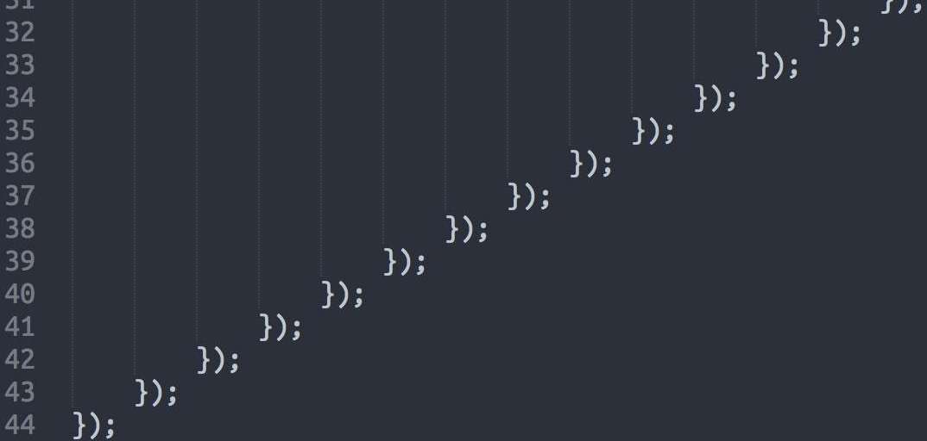
Chaining Promises
Not the ones people make
You can run asynchronous functions in order by chaining them.
CAVEAT
Pyramid of doom
const promise = new Promise((resolve, reject) => {
setTimeout(() => resolve(1), 1000);
}).then(function(result) {
alert(result);
return result * 2;
}).then(function(result) {
alert(result);
return result * 2;
}).then(function(result) {
alert(result);
return result * 2;
});
USEFUL LINKS / JavaScript Demo / Chaining Promises

Slide 13
Promises
myfunction = () => {
...
promise1.then(value1 => {
// Do something with value
promise2.then(value2 => {
// Do something with value
promise3.then(value3 => {
// Do something with value
}).catch(error3 => {
// Do something with error
})
}).catch(error2 => {
// Do something with error
})
}).catch(error1 => {
// Do something with error
});
...
}
Don’t do this
USEFUL LINKS / JavaScript Demo / Chaining Promises
Notes:
Unless for some reason you really need to handle errors for each promise specifically.

Slide 14
Promises
myfunction = () => {
...
promise1.then(value1 => {
// Do something with value
return promise2;
}).then(value2 => {
// Do something with value
return promise3;
}).then(value3 => {
// Do something with value
}).catch(error => {
// Do something with error
error;
})
...
}
A little better
USEFUL LINKS / JavaScript Demo / Chaining Promises
Notes:
You can simply return the next promise that you want to resolve next.

Slide 15
Async / Await
The Hero We Deserved
Promises
Async/Await
myfunction = () => {
...
promise.then(value => {
// Do something with value
}).catch(error => {
// Do something with error
});
...
}
myfunction = async () => {
...
try {
const value = await promise;
// Do something with value
} catch(error) {
// Do something with error
}
...
}
USEFUL LINKS / Async / Await Guide / Try...Catch Statement

Slide 16
Promises
Async/Await
myfunction = () => {
...
promise1.then(value1 => {
// Do something with value
return promise2;
}).then(value2 => {
// Do something with value
return promise3;
}).then(value3 => {
// Do something with value
}).catch(error => {
// Do something with error
error;
})
...
}
myfunction = async () => {
...
try {
const value1 = await promise1;
const value2 = await promise2;
const value3 = await promise3;
// Do something with values
} catch(error) {
// Do something with error
}
...
}
USEFUL LINKS / JavaScript Demo / Chaining Promises

Slide 17

Promises
Async/Await
Hooray for async/await1
myfunction = () => {
...
promise1.then(value1 => {
// Do something with value
return promise2;
}).then(value2 => {
// Do something with value
return promise3;
}).then(value3 => {
// Do something with value
}).catch(error => {
// Do something with error
error;
})
...
}
myfunction = async () => {
...
try {
const value1 = await promise1;
const value2 = await promise2;
const value3 = await promise3;
// Do something with values
} catch(error) {
// Do something with error
}
...
}
USEFUL LINKS / JavaScript Demo / Chaining Promises

Slide 18
Promises
Async/Await
Hooray for async/await1
myfunction = () => {
...
promise1.then(value1 => {
// Do something with value
return promise2;
}).then(value2 => {
// Do something with value
return promise3;
}).then(value3 => {
// Do something with value
}).catch(error => {
// Do something with error
error;
})
...
}
myfunction = async () => {
...
try {
const value1 = await promise1;
const value2 = await promise2;
const value3 = await promise3;
// Do something with values
} catch(error) {
// Do something with error
}
...
}
USEFUL LINKS / JavaScript Demo / Chaining Promises

Slide 19
Networking
The Hero We Deserved
Fetch
const response = await fetch('https://swapi.co/api/people/');
const responseJson = await response.json();
USEFUL LINKS / Fetch Documentation

Slide 20
Live Exercise
Spaceship Store
Familiarize yourself with the App file structure.
Find the function that loads the starship data from SWAPI.
Use fetch to load data.
https://swapi.co
Follow Along
https://reflect.sh/various-ocean

Slide 21



Ending Exercise
Load data from another API
Download
STARTER CODE
Spotify
Unsplash
Map
Example

Slide 22

Next Week
Firebase

Slide 23

Office Hours
Email us directly if you’re not available at these times
Abdallah AbuHashem
Monday (12-1 PM) @ Huang Basement
Or by appointment
Vy Mai
Tuesday (3-4 PM) @ Old Union
Or by appointment
Cisco Vlahakis
Wednesday (8-9 PM) @ Huang Basement
Or by appointment
Tiffany Manuel
Thursday (2-3 PM) @ Huang Basement
Or by appointment
For today’s attendance, please see #general channel in our Slack.
Invitation:
https://tinyurl.com/cs47slack2019

Slide 24
Lecture 7B: Networking

